Slide 1
Examining the Movie Industry Over the Last Four Decades
Group 3: Dan Cahill, Renuka Abbidi, Aditya Ragu, Claire Danahy, Harish Selvakumar, Koushik Talluri

Slide 2




Motivation/Business Context
Streaming services are more prevalent today than ever
Movies are increasingly being released exclusively on these services or released in theaters then on the services shortly after
Some pros to streaming services include comfort, cost, and the ability to take breaks
All this raises the question: Are streaming services harming the movie industry?

Slide 3
Data Description
Scraped from IMDb
Collection of 6820 movies released in years from 1980-2020
Each has numerous attributes such as the name, genre, budget, director, etc.
This data set helps to analyze the industry to gain insights into whether it is dying and whether streaming services are the new entertainment king.
Name - name of the movie
Rating - rating of the movie (R, PG, etc.)
Genre - main genre of the movie
Year - year of release
Released - release date (YYYY-MM-DD)
Score - IMDb user rating
Votes - number of user votes
Director - director of the movie
Writer - writer of the movie
Star - main actor or actress
Country - country of origin
Budget - budget of the, some don’t have one so it is shown as a 0
Gross - revenue of the movie
Company - production company
Runtime - length of the movie

Slide 4
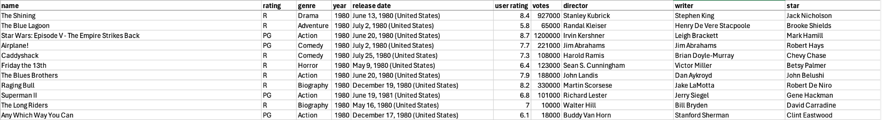
Data Preparation
Handle all cases of missing data
For categorical data like rating, company, release date, and writer, replace the missing values with “Unknown”
For numeric data like budget, gross, runtime, scores, and votes, replace the missing values with the averages of each column
Change some variable names for easier understanding
Released to release date
Gross to revenue
Score to user rating

Slide 5
Research Questions
What, if any, is the correlation between the budget and the director of a movie?
Does the main actor or actress influence the revenue earned by the movie?
What are the trends between budgets and the country of origin? Where are movies most expensive to create?
How has the popularity in genres changed over the last decades? Which genre was most popular in each of the four decades?
How does the year a movie is released affect the score it receives?
How do movies with a zero dollar budget perform in terms of scores and revenue?

Slide 6
Methodologies
Imported the csv file containing our data into excel
Cleaned up the data by replacing missing values
Utilized Tableau to create visualizations to answer our research questions
Visualizations made include a bar chart, scatter plot, line charts, etc.

Slide 7
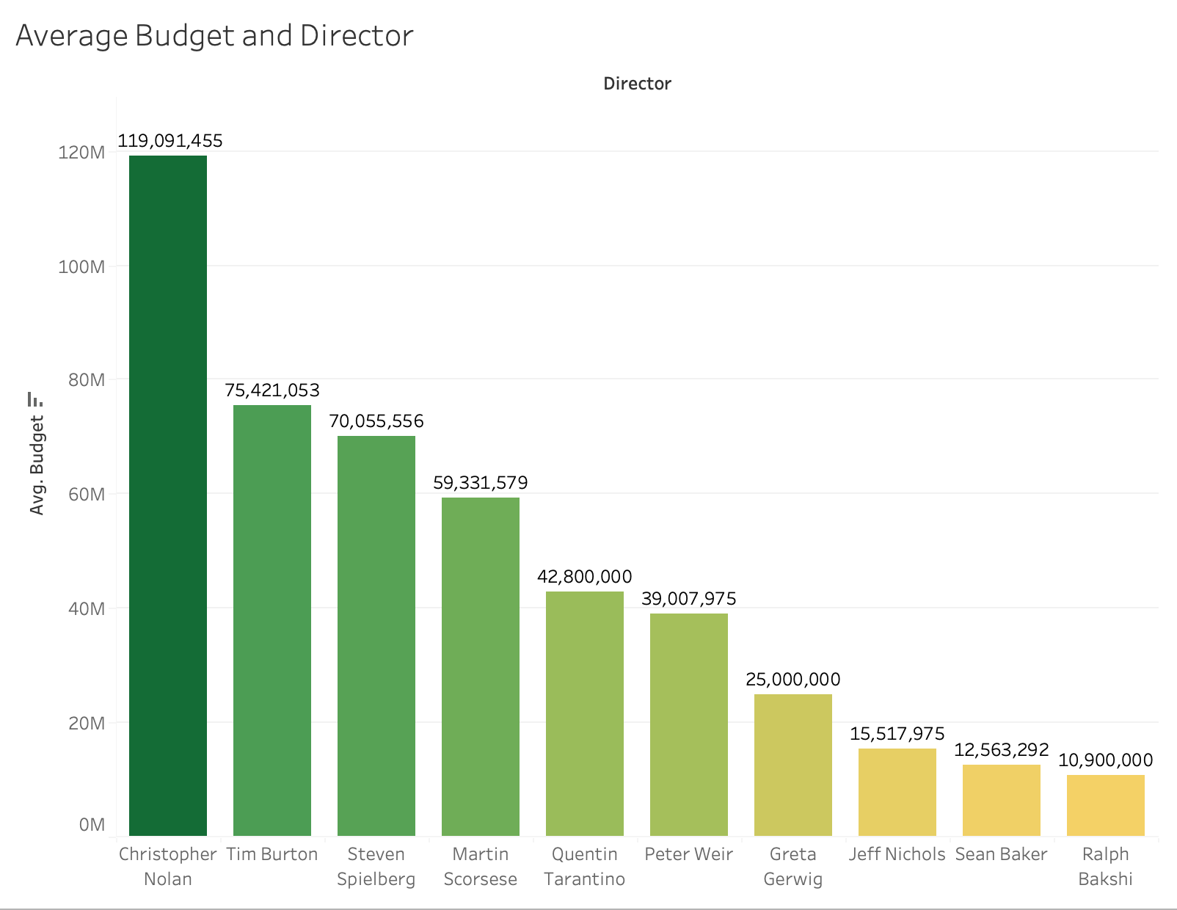
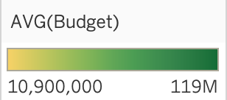
What, if any, is the correlation between the budget and the director of a movie?
Using the average budget for each director, we filtered the data to look at five well known directors and five lesser known directors
It seems that the more popular directors have bigger budgets than directors that are less well known
We can see that Christopher Nolan, director of Interstellar and Oppenheimer, has an average budget of about 120 million dollars while Sean Baker, director of Anora and The Florida Project, has an average budget of about 12.5 million dollars
It may be worth noting that the directors with the smaller budgets seem to direct movies that are not as well known

Slide 8
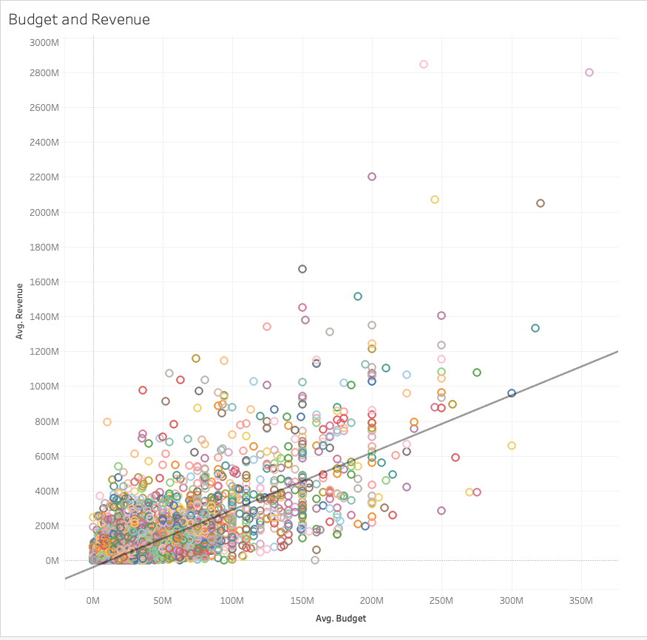
Does the budget influence the revenue earned by the movie?
Using average revenue and average budget, we created a scatter plot to analyze the correlation between the two variables
Added a trend line and distinguished each movie name by color
The trend line shows that there is a positive correlation between the two variables which suggests that movies with higher budgets tend to have higher revenue
However, the data is widely scattered around the line, indicating that revenue is not the only factor in how a movie performs

Slide 9
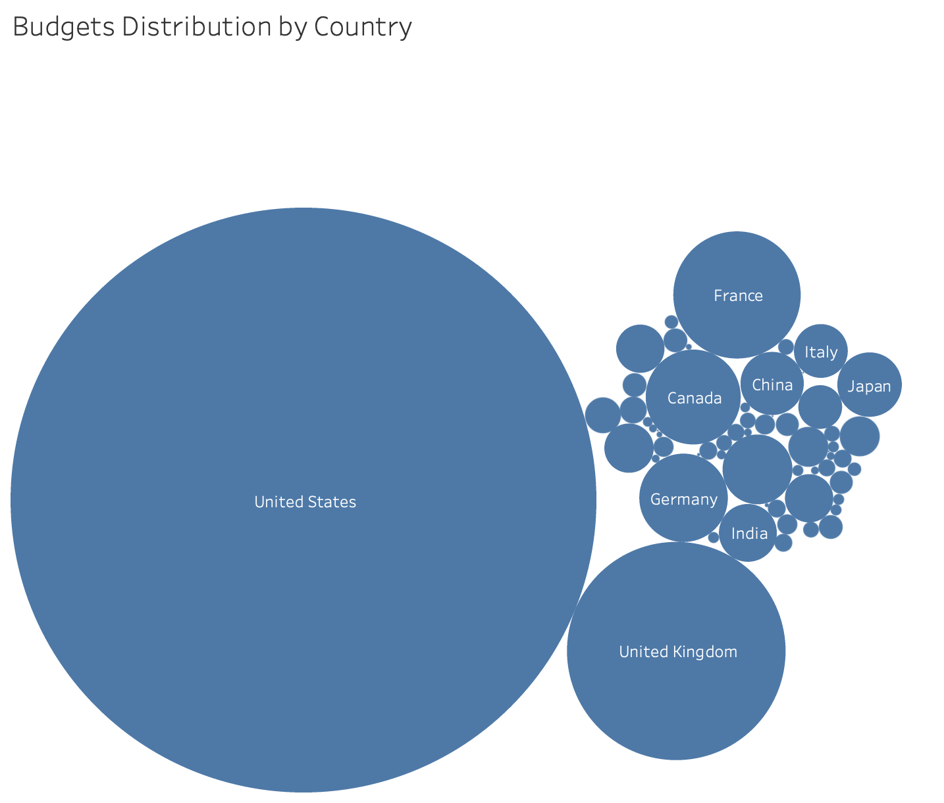
What are the trends between budgets and the country of origin? Where are movies most expensive to create?
The bubble chart effectively compares distribution of movie budgets by country, showing dominance of united states in movie production costs.
The size of bubbles highlight high-budget movies in a few countries.
Other significant countries are France, Canada, Germany, Japan, China, India and Italy.

Slide 10
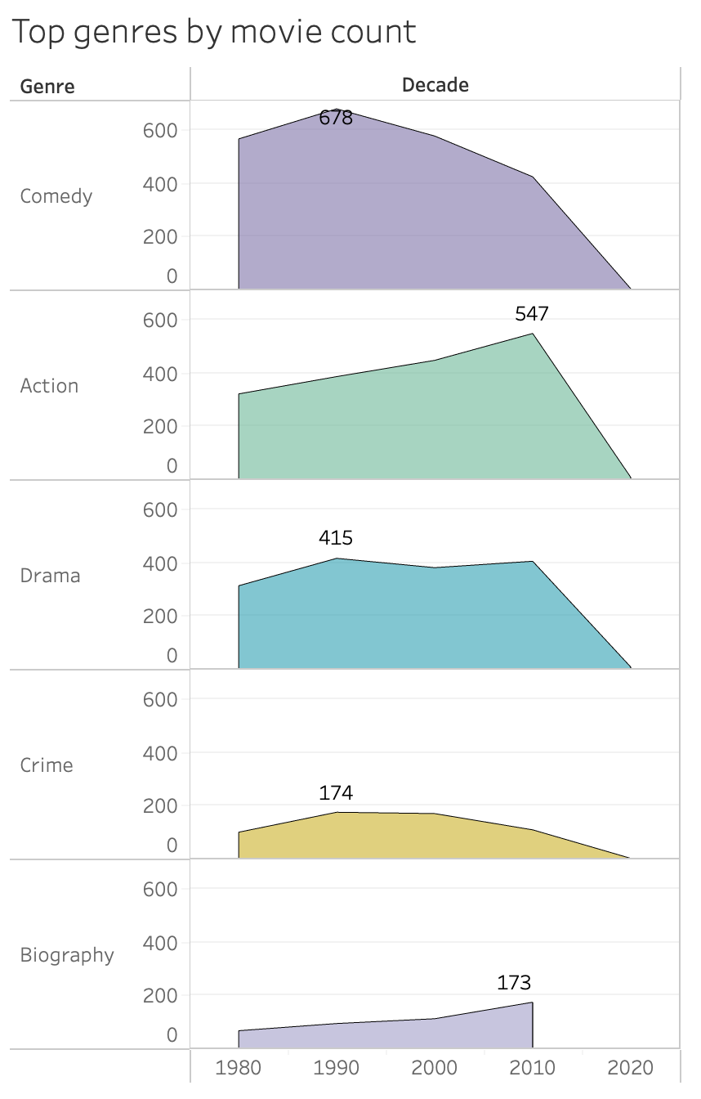
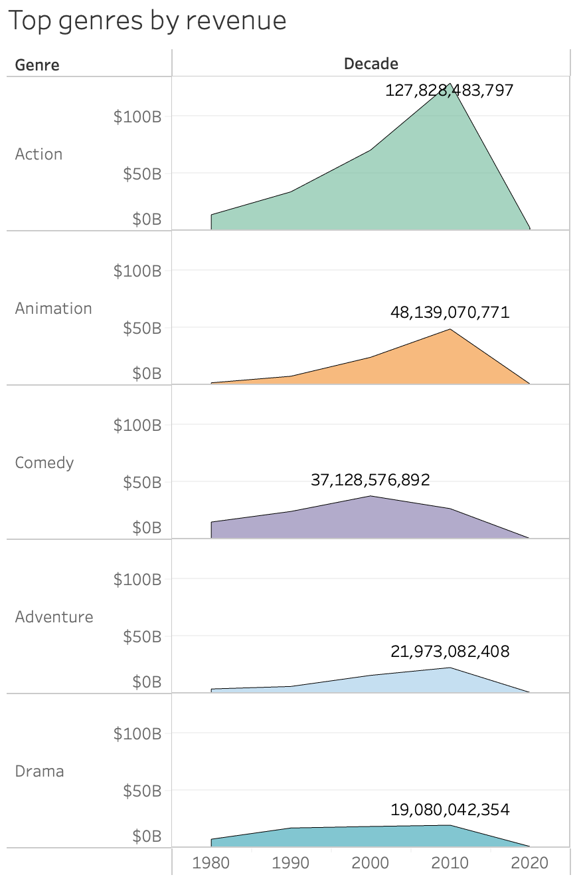
Do genres that produce more movies generate the most revenue?
Genres with high number of movies like Comedy and Drama, do not necessarily generate the most revenue
Genres like Animation and Adventure generate substantial revenue despite producing fewer movies. (which we cannot see in the left graph as they are not in the top 5 by movie count)
The relationship between movie production and revenue is not linear.
Certain genres higher profitability likely due to large-scale production and strong audience appeal.

Slide 11
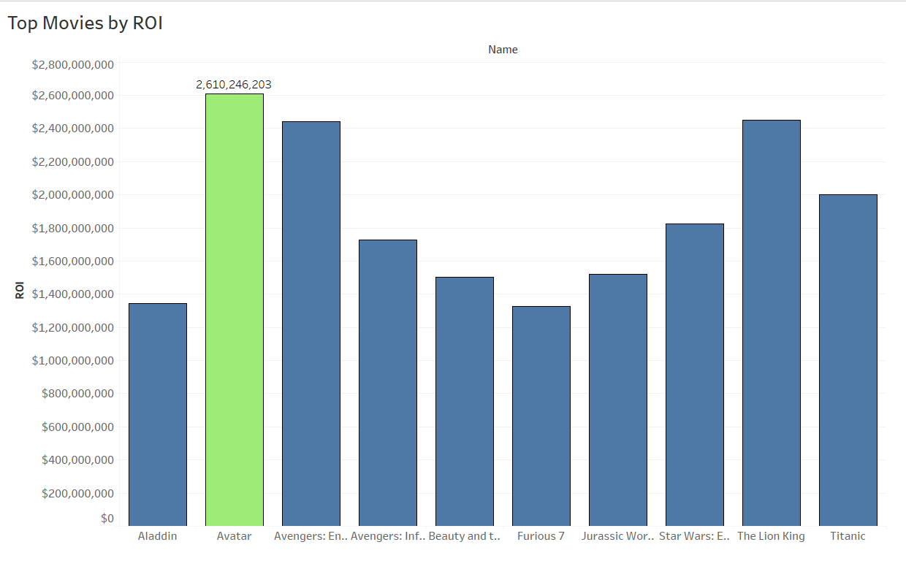
What are top 10 Movies by Return on Investment?
The graph highlights Top 10 ROI for movies, with a notable peak represented by Avatar.
Highest ROI: Starting from the observed movies, Avatar marks the most significant ROI increase, standing out with a value of approximately 2.61 billion, far surpassing the others.
Consistent Performers: Other movies like Avengers: EndGame and The Lion King demonstrate strong and steady ROI values, reflecting their high commercial success.

Slide 12
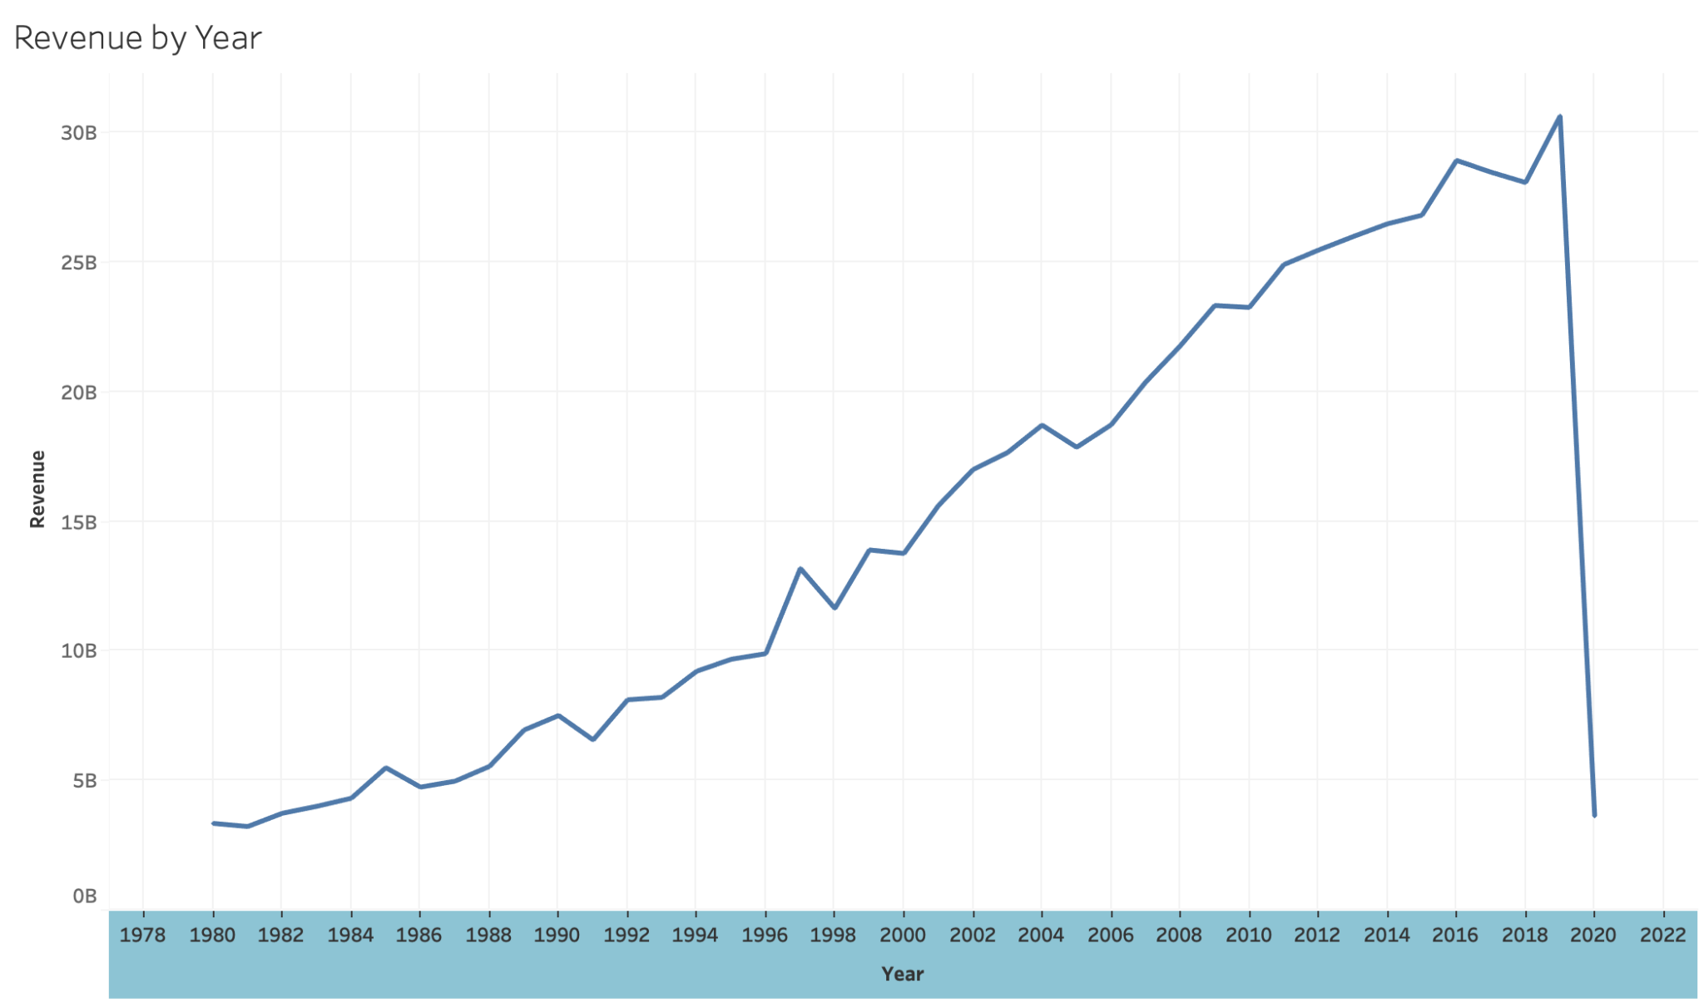
How has the annual revenue from movies evolved over time? Were there any significant fluctuations, and if so, what would have caused them?
From the line chart we can see that the annual revenue has increased over the last few decades
Many factors could be credited for this increase such as media becoming more widespread and the introduction of streaming services
We can see a significant drop in revenue in the year 2020 which is likely due to COVID and theatres being shut down

Slide 13
Lessons Learned
Different aspects of a visualization like color and size are extremely beneficial and important when it comes to understanding the data
Data quality is crucial for accurate visualizations
Replacing missing values in numerical variables with the average of each column rather than zeros helps not skew the data and allows for better visualizations and in turn better understanding of the data
You need to be careful when choosing the type of visualization to use when handling large datasets
Tailor the visualization style and complexity based on the target audience’s familiarity with data interpretation.
Simplify charts to prevent overwhelming viewers with too much information. Focus on key insights.

